Slide 1


<Yulong WANG>
<2021-09-01>

Slide 2

Outline
Executive Summary
Introduction
Methodology
Results
Conclusion
Appendix

Slide 3
Executive Summary
Summary of methodologies
In order to predict if the first stage of the SpaceX Falcon 9 rocket will land successfully, the methods of data collection, data wrangling, exploratory data analysis, data visualization, model development, model evaluation are applied.
Summary of all results
Launch site has a strong relation with success rate.
CCAFS SLC-40 and KSC LC-39A are most feasible sites with highest success rate and amount of launch.
The ocean & RTLS outcome have succussed on small and medium mass launches, and there is more chances for improvement.

Slide 4
Introduction
Project background and context
SpaceX advertises Falcon 9 rocket launches on its website, with a cost of 62 million dollars; other providers cost upward of 165 million dollars each, much of the savings is because SpaceX can reuse the first stage.
Problems you want to find answers
Sources of data
Data managing
Data processing
Data analysis
Data understanding

Slide 5


Slide 6
Methodology
Executive Summary
Data collection methodology:
API and web scraping mechanics are applied to collect the data.
Perform data wrangling
Preprocess includes filling NaN, discard outlier, generating secondary data, ect.
Perform exploratory data analysis (EDA) using visualization and SQL
Perform interactive visual analytics using Folium and Plotly Dash
Perform predictive analysis using classification models
Several classification models are built after exploratory, for example data standardize, training and test data split, parameters are tuned by using the grid searching method, finally, the best performance model is decided by score evaluation.

Slide 7



Data Collection
We can say that there is no data there is no scientific data. Therefore, the fastest way to collect big data is through the Internet.
API is the acronym for Application Programming Interface, which is a software intermediary that allows two applications to talk to each other. Web scraping is the process of using bots to extract content and data from a website.

Slide 8
Data Collection – SpaceX API
A get request to the SpaceX Application Programming Interface (API), also the JSON to extract data about boosters.
IBM Watson Studio JupyterNotebook Link
Github JupyterNotebook Link

Slide 9
Data Collection - Scraping
A get request to the SpaceX Application Programming Interface (API), also the JSON to extract data about boosters.
IBM Watson Studio JupyterNotebook Link
Github JupyterNotebook Link

Slide 10
Data Wrangling
Transforming and mapping data from raw data, which including transforming data to dataframe, discarding the null values, discarding the outliers, normalizing the values, and some basic data exploring.
Raw data
Dataframe
Remove null values
remove outliers
Normalizing
Modeling
IBM Watson Studio JupyterNotebook Link
Github JupyterNotebook Link
IBM Watson Studio JupyterNotebook Link
Github JupyterNotebook Link

Slide 11
EDA with Data Visualization
Scatter plot, Bar plot, and Line plot are used to visualize the data.
IBM Watson Studio JupyterNotebook Link
Github JupyterNotebook Link
Scatter plot
Variable relationship
Easy to handle
Bar plot
Categorical relationship
Impact visualization
Line plot
Timeseries tendency

Slide 12
EDA with SQL
IBM Watson Studio JupyterNotebook Link
Github JupyterNotebook Link
%load_ext sql
Load the sql and build a connection
%%sql
Magic command for sql in python
Where: extract or filter conditions
Like: character string match detection
Group by: summary rows
Between: select values within a range
Order: sort the result in order

Slide 13
Build an Interactive Map with Folium
IBM Watson Studio JupyterNotebook Link
Github JupyterNotebook Link
Summary of map objects:
Markers: show a geo location from lat and lon data
Cluster: show a group of markers
Circles: show a single location
Lines: show distance between two markers

Slide 14
Build a Dashboard with Plotly Dash
IBM Watson Studio JupyterNotebook Link
Github JupyterNotebook Link
Summary of plots:
Bar: shows categories differences
Line: reports timeseries changes
Pie: shows the percentage of events
Tree: shows complex relationship of variables in interactive way
Map: shows variables of states on a map

Slide 15
Predictive Analysis (Classification)
Split train/test data
Design parameter for gird search
Decide the best parameters
Make model and predict target values
The models are trained by the spited data sets, the optimal parameters are decided by applying grid searching method, and evaluated by scores.
IBM Watson Studio JupyterNotebook Link
Github JupyterNotebook Link

Slide 16
Results
Exploratory data analysis results
Both API and web crawling are capable to collect Xspace data
Interactive analytics demo in screenshots
EDA with sql is effective for data filtering
EDA with interactive visualization provides informative information
Plotly Dash is powerful to show instant data change
Predictive analysis results
The logistical regression model has the best accuracy of predicting.

Slide 17


Slide 18
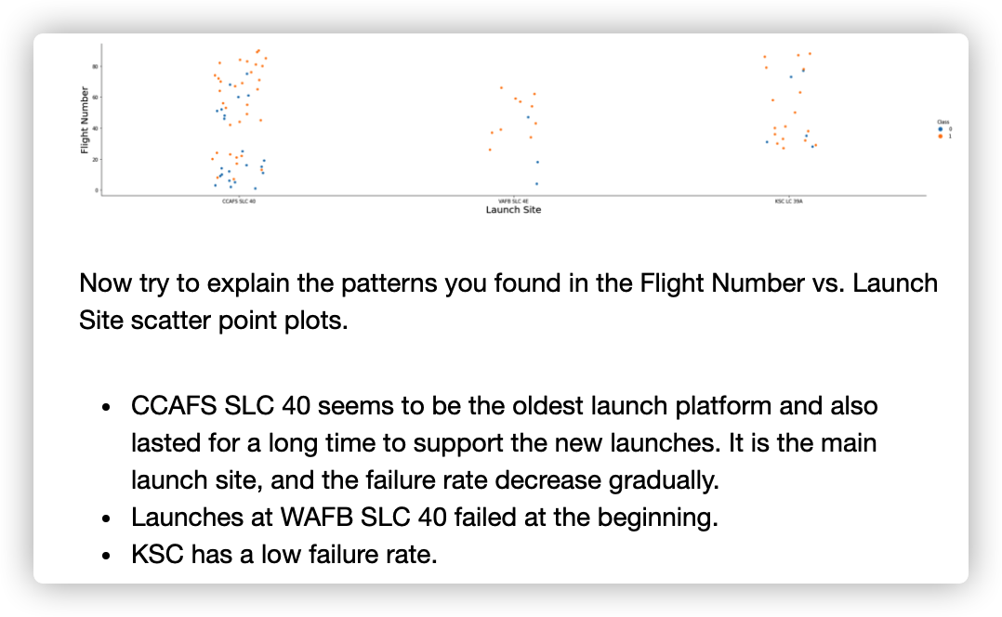
Flight Number vs. Launch Site
Show a scatter plot of Flight Number vs. Launch Site
Show the screenshot of the scatter plot with explanations

Slide 19
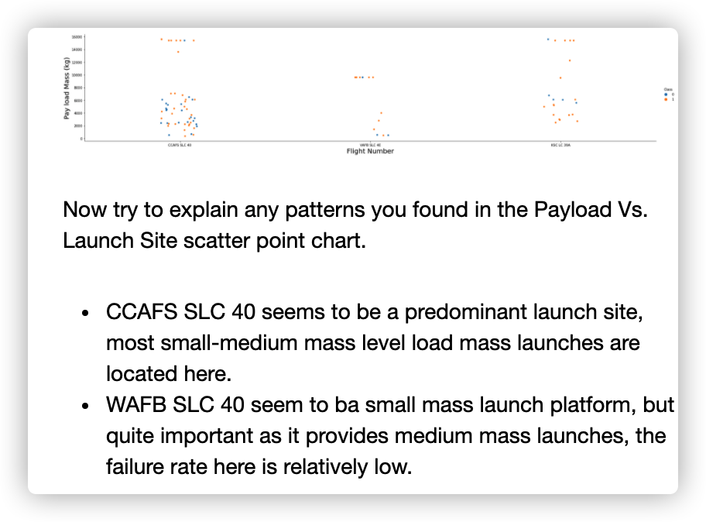
Payload vs. Launch Site
Show a scatter plot of Payload vs. Launch Site
Show the screenshot of the scatter plot with explanations

Slide 20
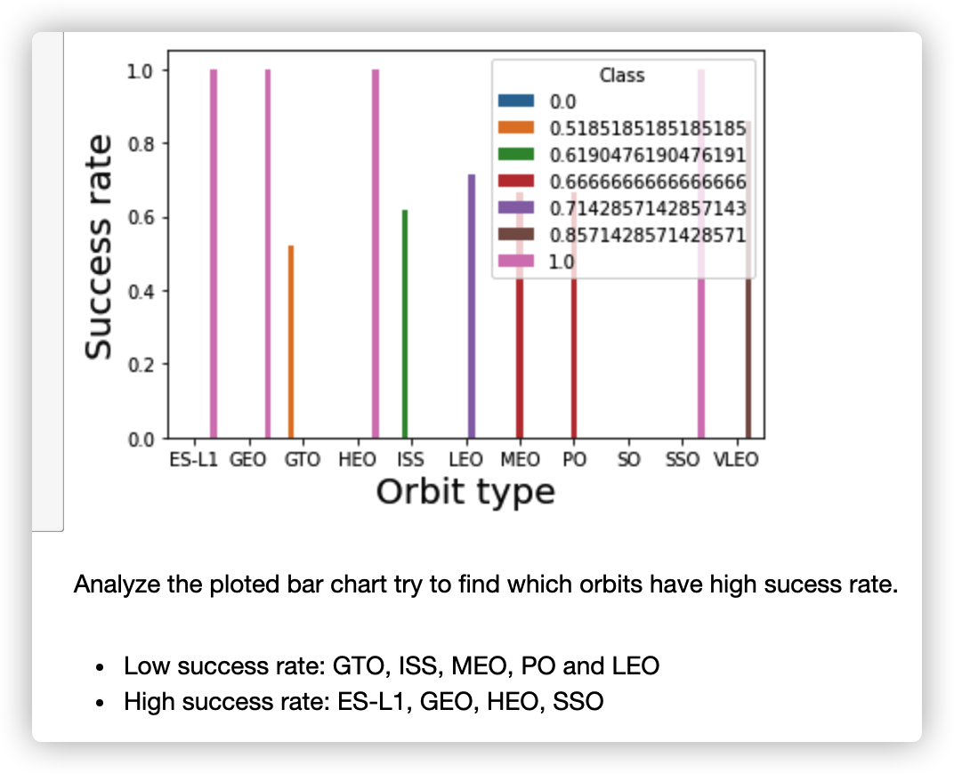
Success Rate vs. Orbit Type
Show a bar chart for the success rate of each orbit type
Show the screenshot of the scatter plot with explanations

Slide 21
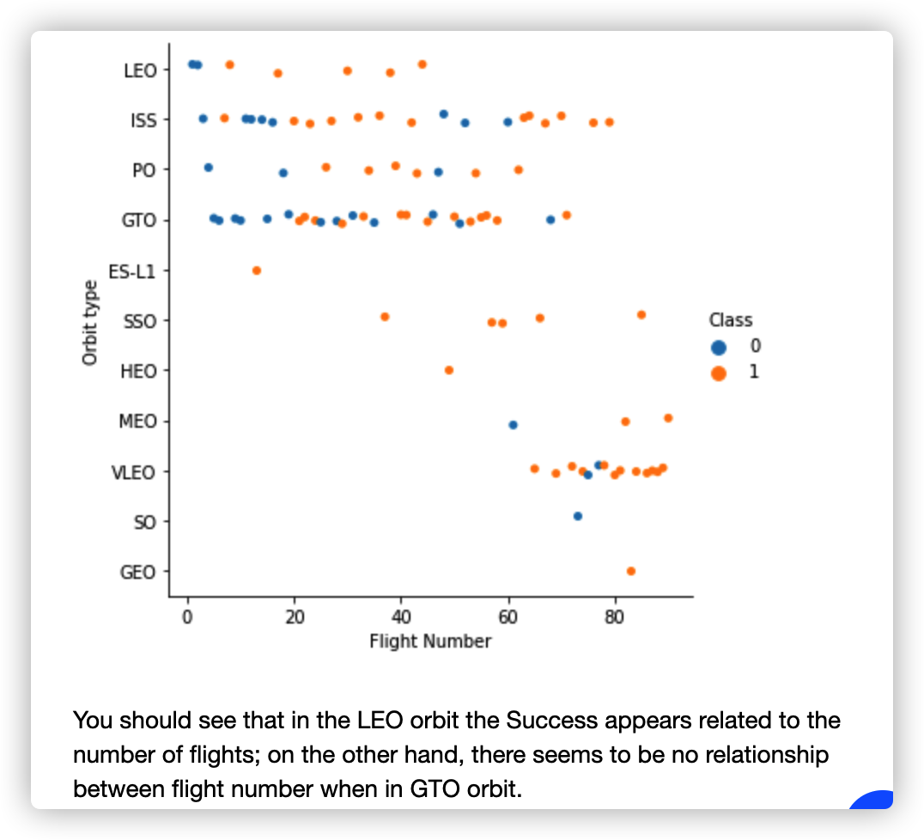
Flight Number vs. Orbit Type
Show a scatter point of Flight number vs. Orbit type
Show the screenshot of the scatter plot with explanations

Slide 22
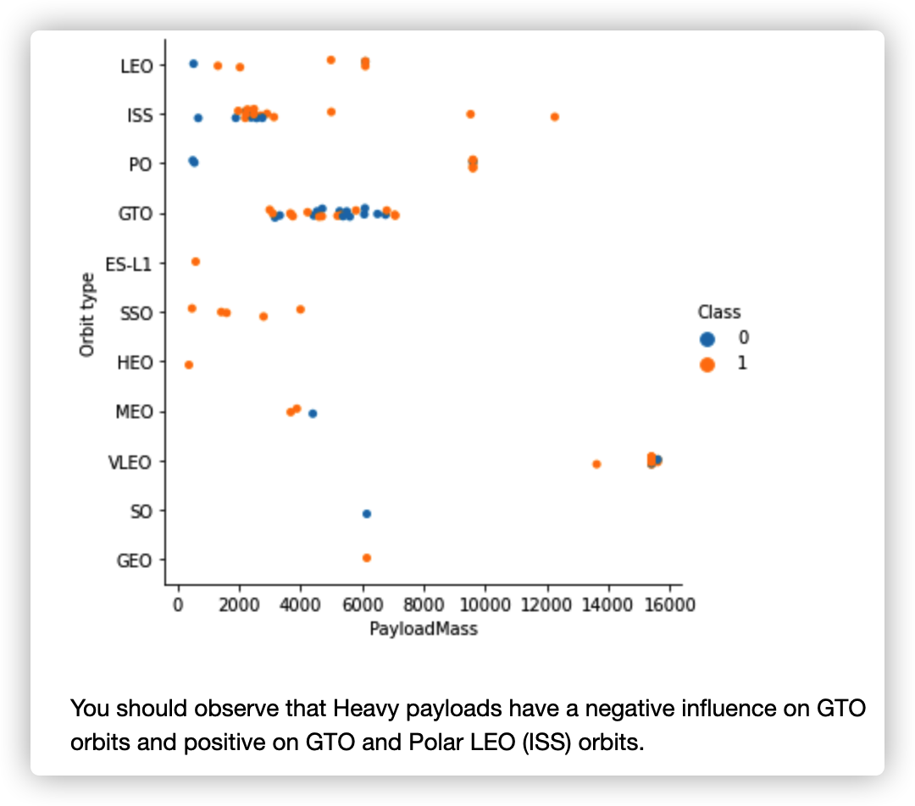
Payload vs. Orbit Type
Show a scatter point of payload vs. orbit type
Show the screenshot of the scatter plot with explanations

Slide 23
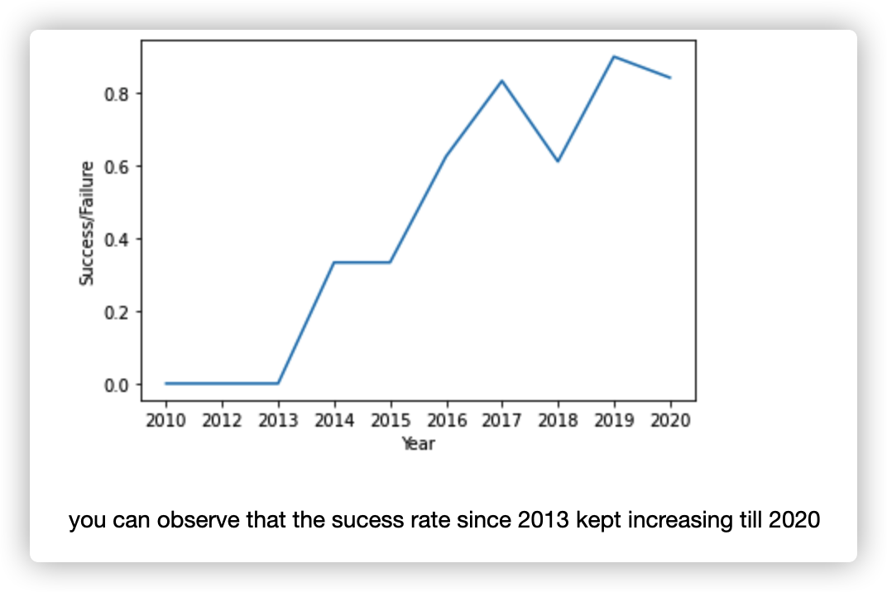
Launch Success Yearly Trend
Show a line chart of yearly average success rate
Show the screenshot of the scatter plot with explanations

Slide 24
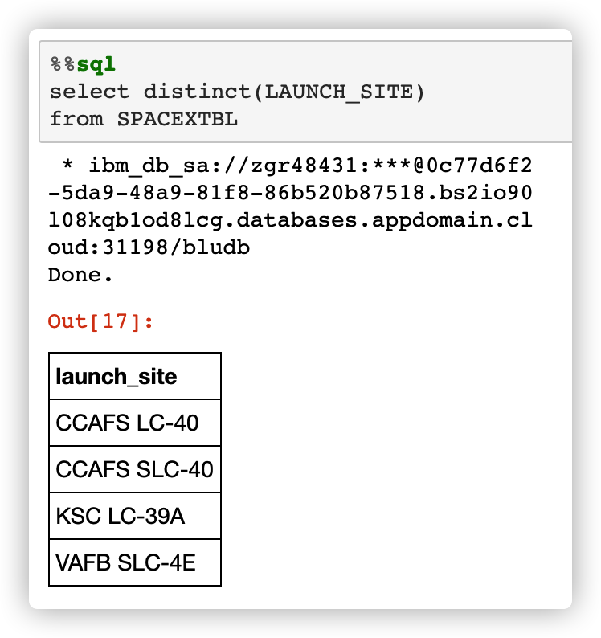
All Launch Site Names
Find the names of the unique launch sites
Present your query result with a short explanation here
There are four launch sites, CCAFS LC-40, CCAFS SLC-40, KSC LC-39A, and VAFB SLC-4E.

Slide 25
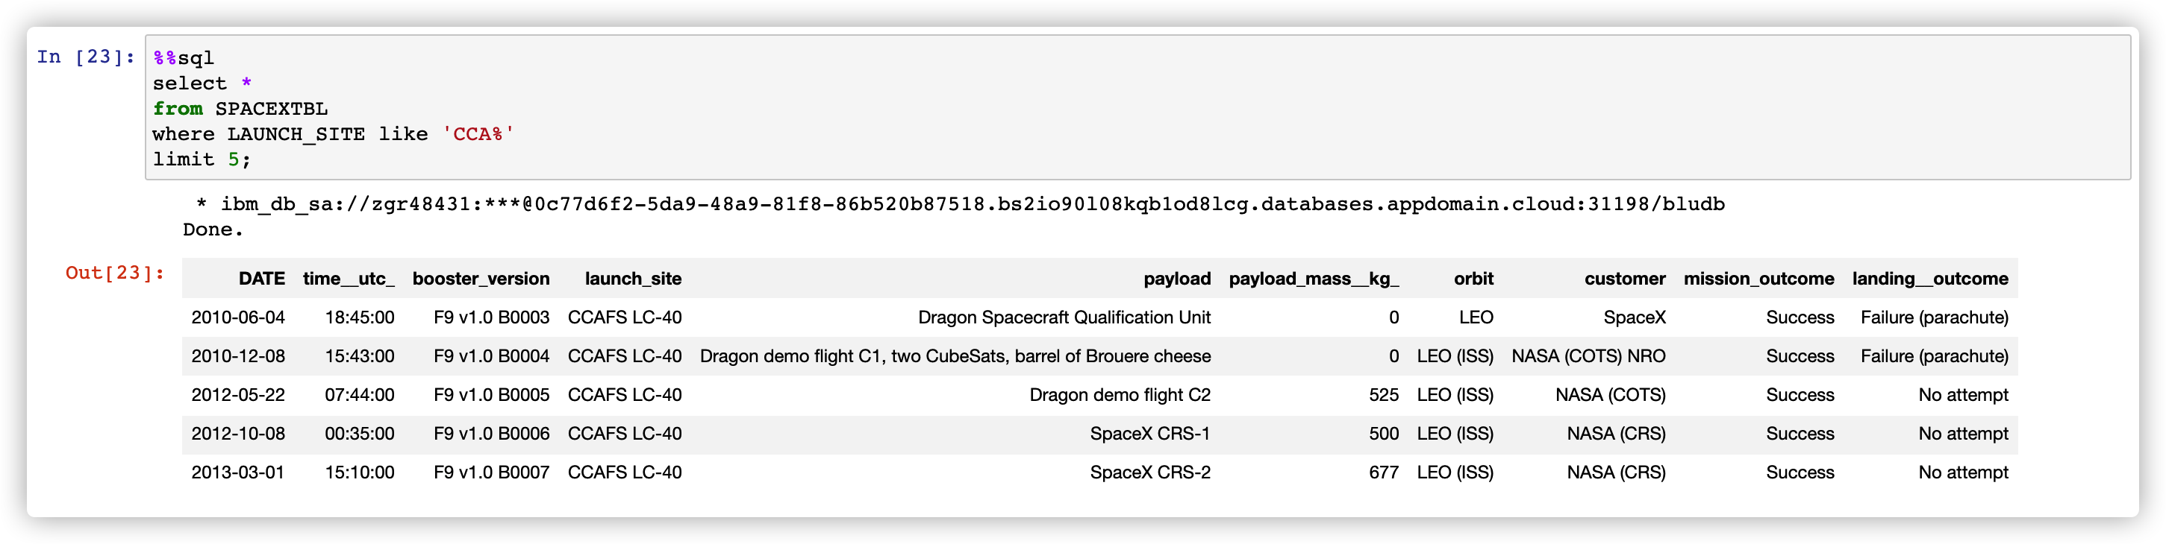
Launch Site Names Begin with 'CCA'
Find 5 records where launch sites begin with `CCA`
Present your query result with a short explanation here
They are all CCAFS LC-40.

Slide 26
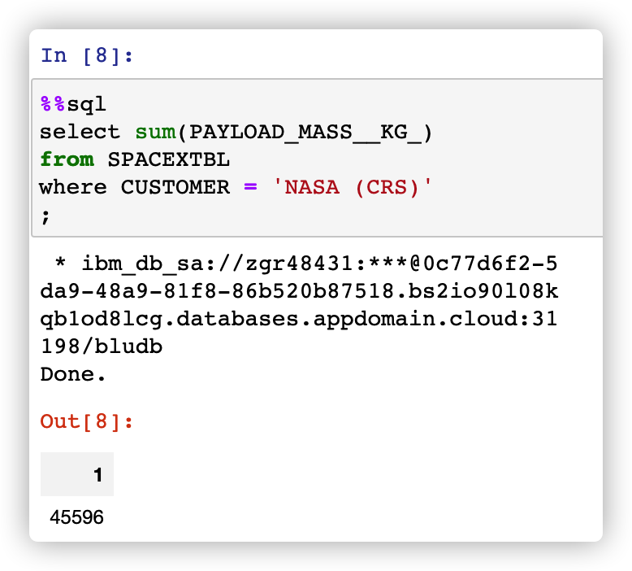
Total Payload Mass
Calculate the total payload carried by boosters from NASA
Present your query result with a short explanation here
Well, um… no idea about it…

Slide 27
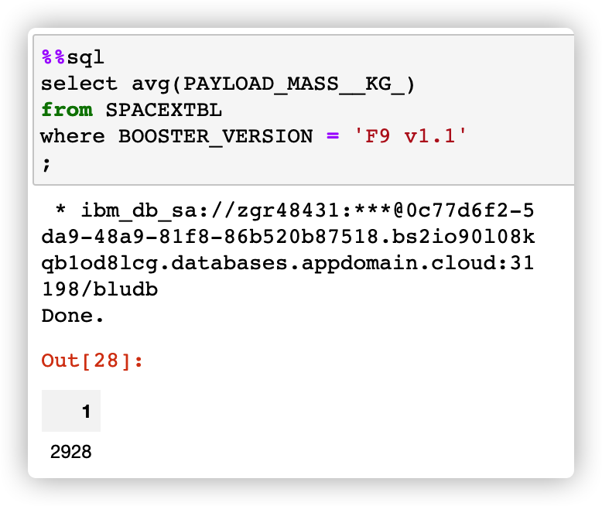
Average Payload Mass by F9 v1.1
Calculate the average payload mass carried by booster version F9 v1.1
Present your query result with a short explanation here
Average of 3000 kg, quite small mass.

Slide 28
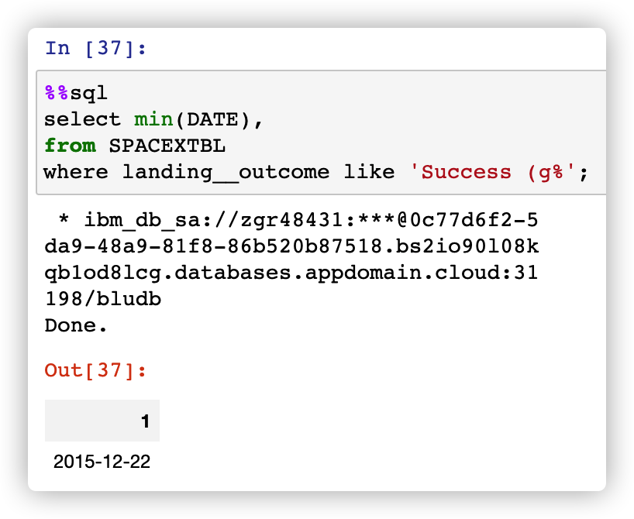
First Successful Ground Landing Date
Find the dates of the first successful landing outcome on ground pad
Present your query result with a short explanation here
First successful landing after 5 years attempts, LOL!!

Slide 29
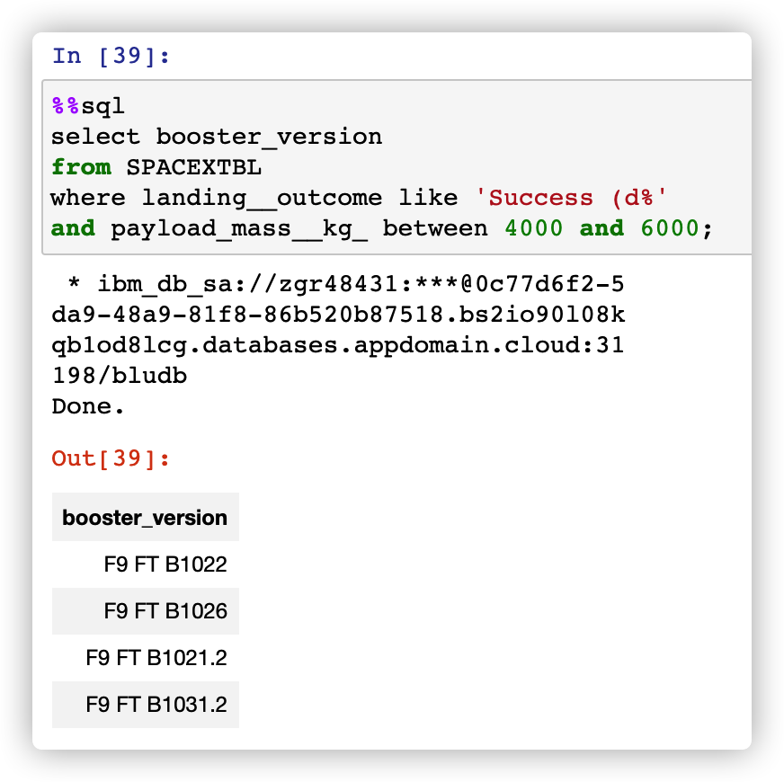
Successful Drone Ship Landing with Payload between 4000 and 6000
List the names of boosters which have successfully landed on drone ship and had payload mass greater than 4000 but less than 6000
Present your query result with a short explanation here
The version code seem to be continued

Slide 30
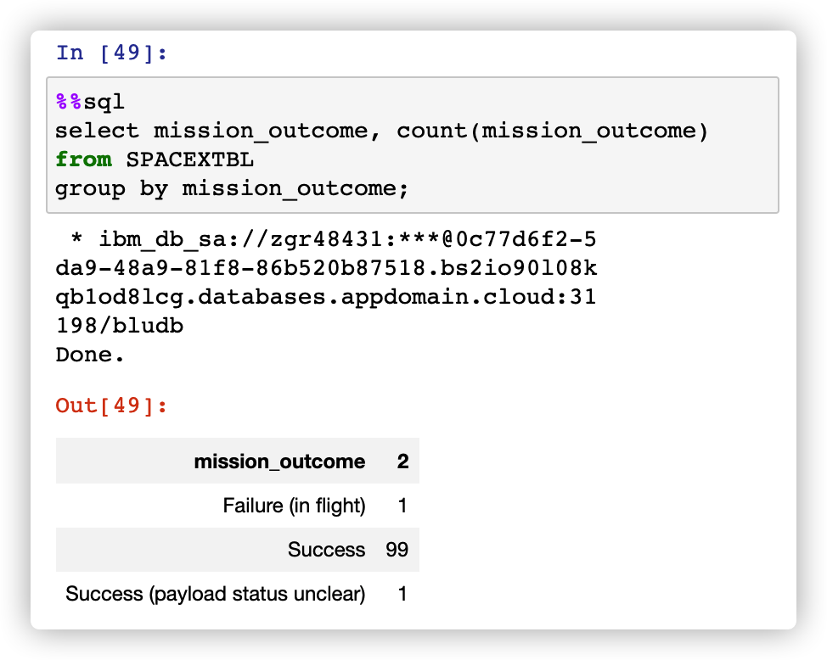
Total Number of Successful and Failure Mission Outcomes
Calculate the total number of successful and failure mission outcomes
Present your query result with a short explanation here
Mission outcomes are preforming well

Slide 31
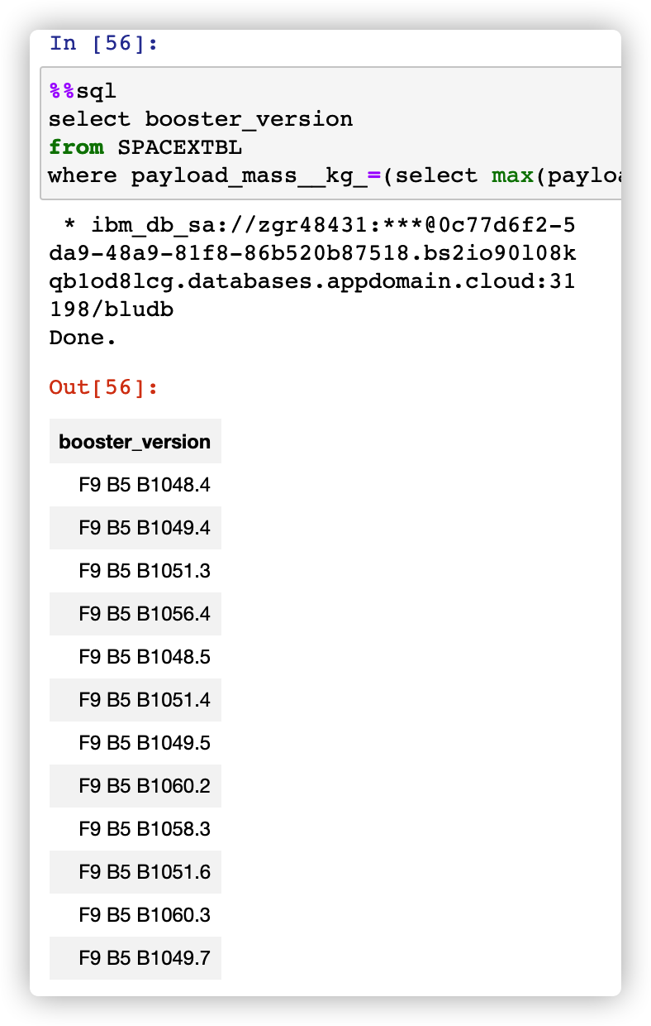
Boosters Carried Maximum Payload
List the names of the booster which have carried the maximum payload mass
Present your query result with a short explanation here
The version code seem to be continued

Slide 32
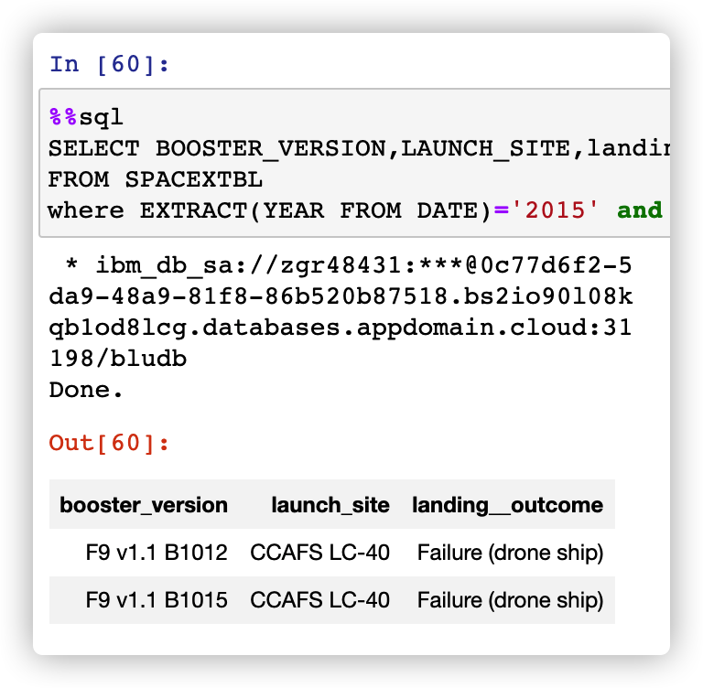
2015 Launch Records
List the failed landing_outcomes in drone ship, their booster versions, and launch site names for in year 2015
Present your query result with a short explanation here
Maybe drone ship is problem before improvement

Slide 33
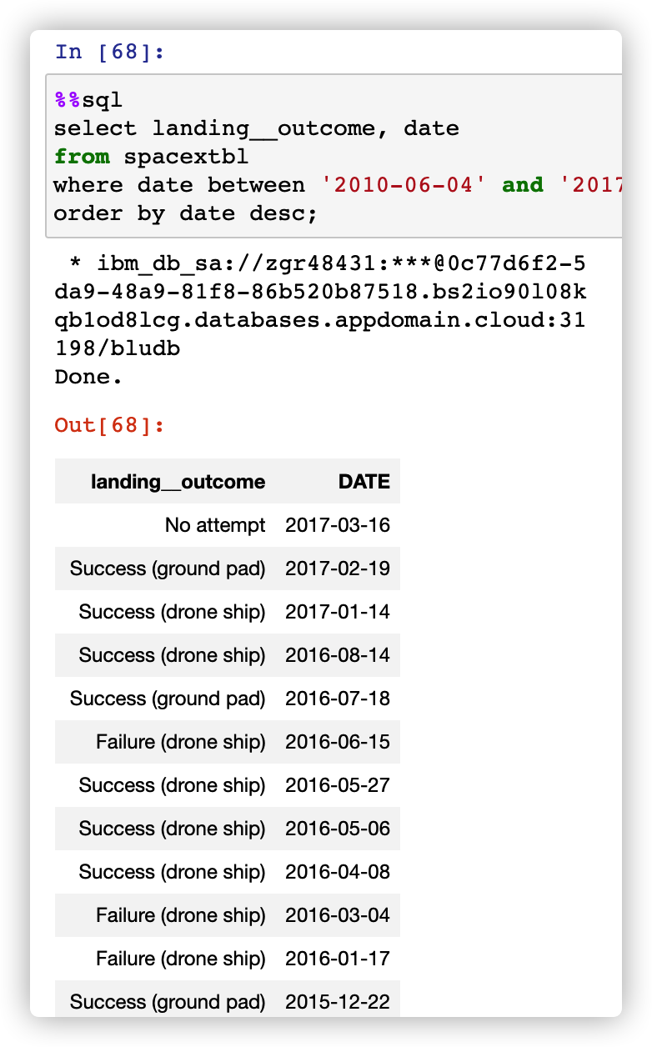
Rank Landing Outcomes Between 2010-06-04 and 2017-03-20
Rank the count of landing outcomes (such as Failure (drone ship) or Success (ground pad)) between the date 2010-06-04 and 2017-03-20, in descending order
Present your query result with a short explanation here
Most failure cases are on drone ship recently.

Slide 34


Slide 35
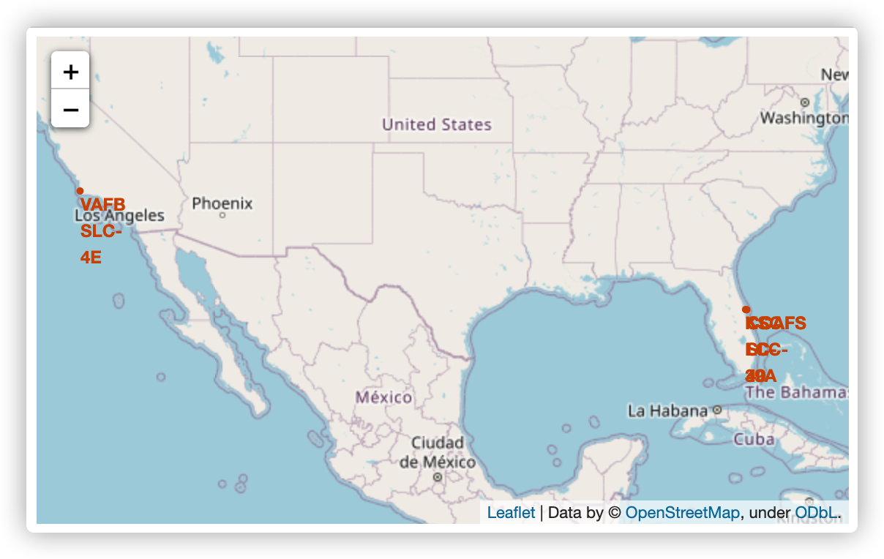
Best launch sites
Explain the important elements and findings on the screenshot
Both ground and sea surface sites are necessary, also, south areas maybe a proper areas.
The transportation base chosen maybe important

Slide 36
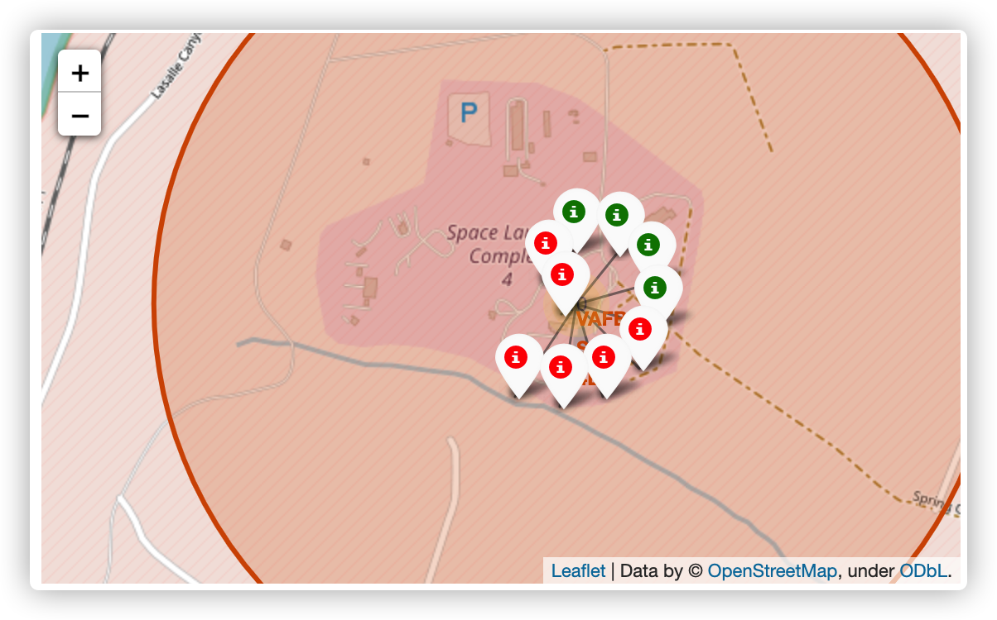
Red vs. Green
Explain the important elements and findings on the screenshot
Color icons is impressive way to show the rate of success, in VABF, failure rate is high.

Slide 37
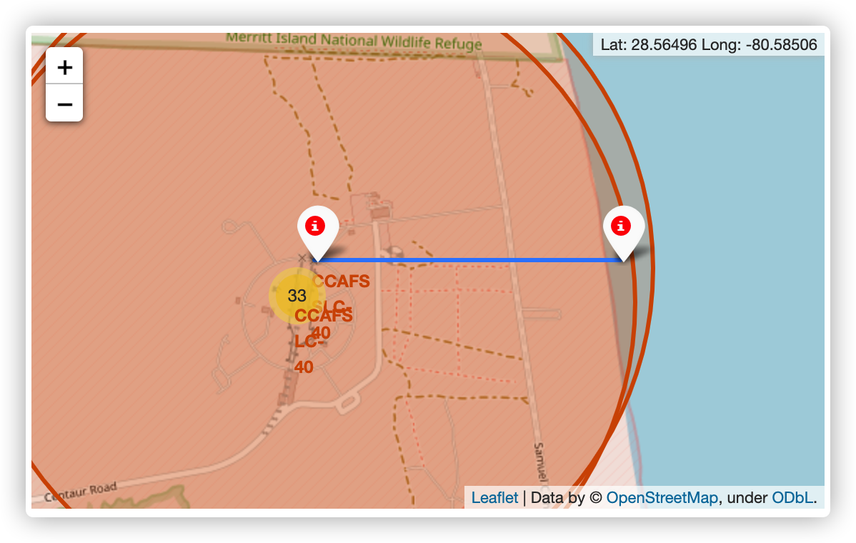
Transportation
Explain the important elements and findings on the screenshot
Visualization shows importance of transportation, for example the railway, coast or port.

Slide 38


Slide 39
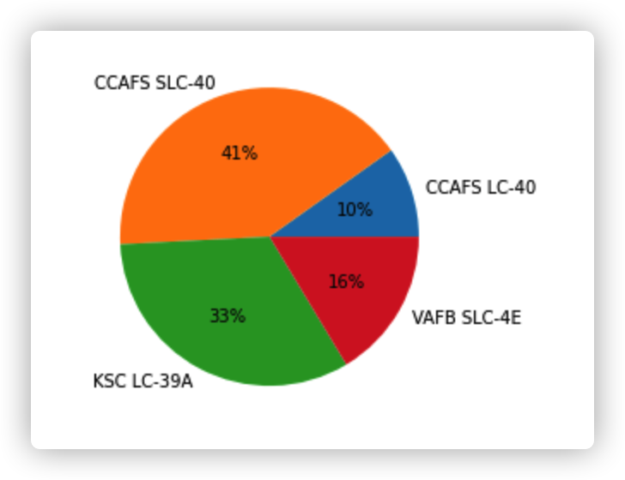
The most successful launch site
Explain the important elements and findings on the screenshot
Key findings: The most successful launch sites are CCAFS SLC-40 and KSC LC-39A

Slide 40
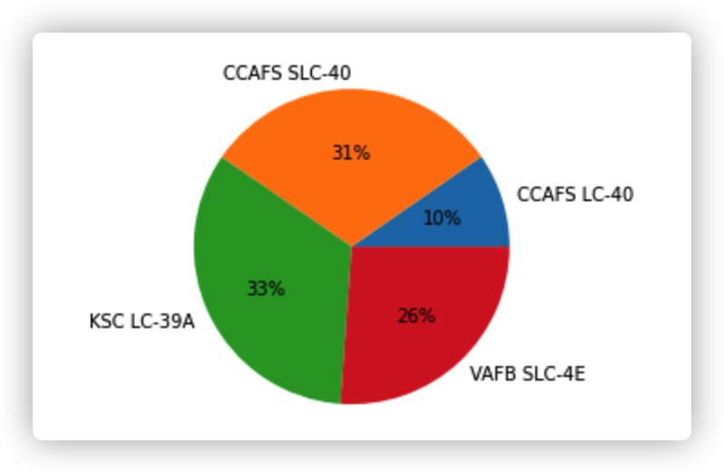
The most feasible launch site
Explain the important elements and findings on the screenshot
KSC LC-39A has the highest successful rate.
The CCAFS SLC-40 follows.

Slide 41
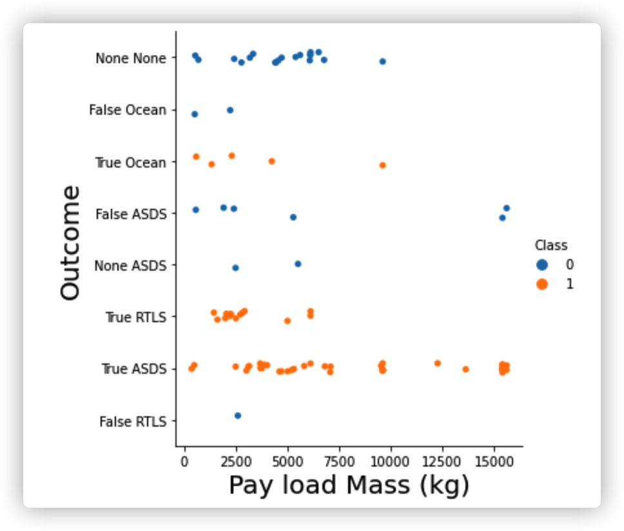
Promising launch sites
Explain the important elements and findings on the screenshot, such as which payload range or booster version have the largest success rate, etc.
One key point:
The ocean & RTLS outcome has high successful rate for the small and medium mass launch

Slide 42


Slide 43
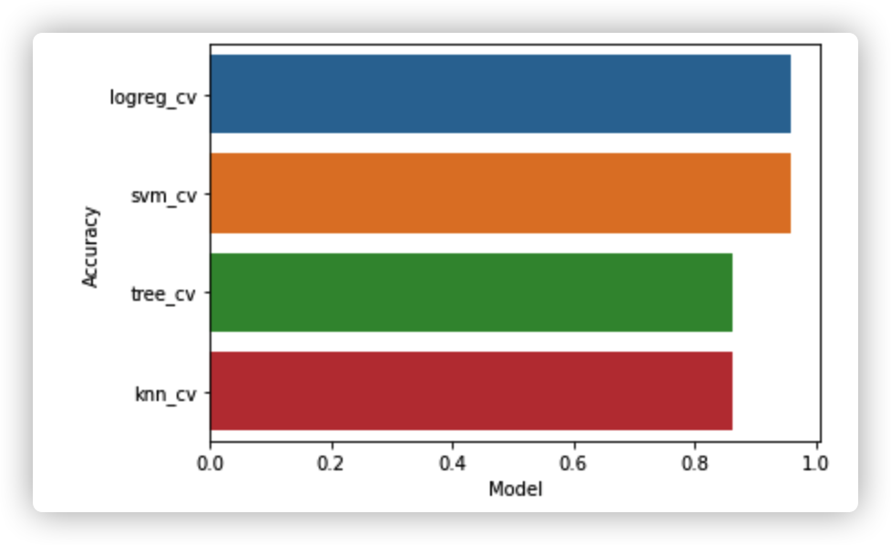
Classification Accuracy
Visualize the built model accuracy for all built classification models, in a bar chart
Find which model has the highest classification accuracy
logistic regression model

Slide 44
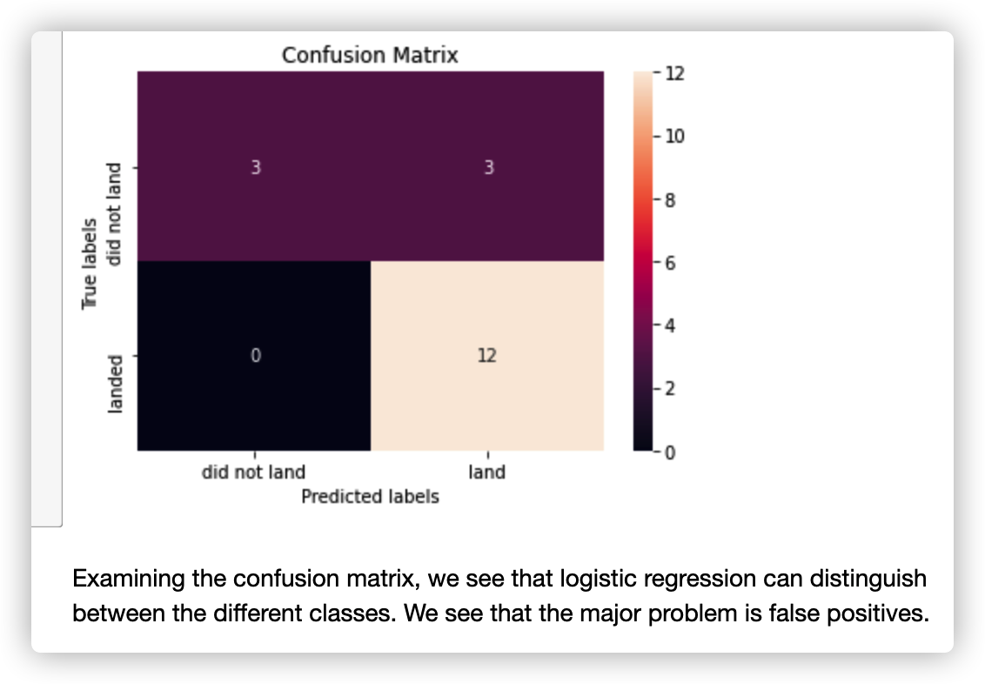
Confusion Matrix
Show the confusion matrix of the best performing model with an explanation

Slide 45
Conclusions
Point 1: Launch site has a strong relation with success rate.
Point 2: CCAFS SLC-40 and KSC LC-39A are most feasible sites with highest success rate and amount of launch.
Point 3: The ocean & RTLS outcome have succussed on small and medium mass launches, and there is more chances for improvement.

Slide 46
Appendix
Include any relevant assets like Python code snippets, SQL queries, charts, Notebook outputs, or data sets that you may have created during this project
SpaceX Falcon 9 first stage Landing Prediction
Space X Falcon 9 First Stage Landing Prediction
Complete the EDA with SQL lab
Complete the EDA with Visualization lab
Launch Sites Locations Analysis with Folium
Space X Falcon 9 First Stage Landing Prediction

Slide 47


